Slide 1

Fruit image Classification and identification of its ripeness Using Deep Learning
Capstone Project Phase 1 Project 23-1-R-7
Students:
Shani Froik
Lior Saghi
Supervisor:
Ilya Zeldner

Slide 2
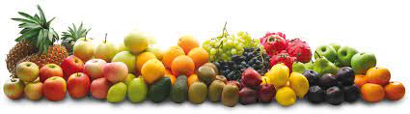
Introduction
Helps people's health
Helps people with disabilities
Manual sorting is not good enough

Slide 3
Proposed model
Classification fruit type
Classification the level fruit ripeness
Using deep learning architecture

Slide 4
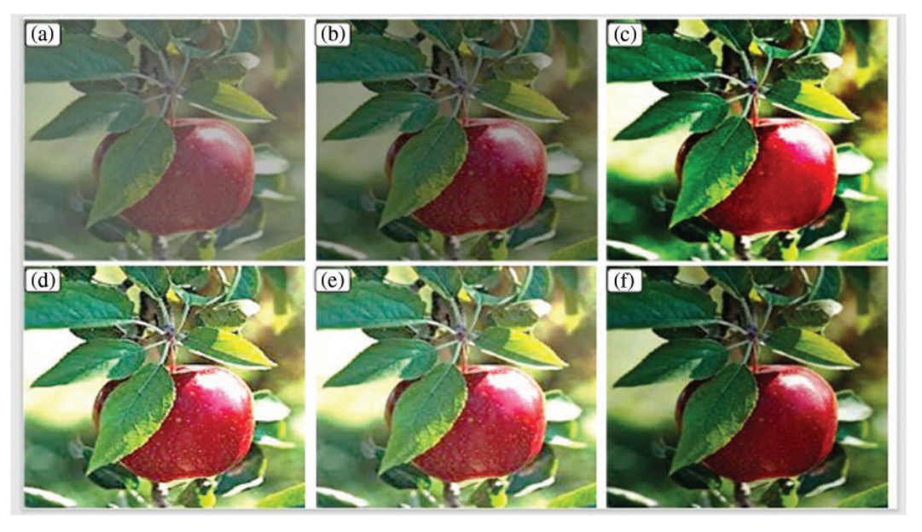
Classification fruit type
Using Type-II Fuzzy to enhance fruit image
Fruit image visual analysis (a) input image, (b) enhanced by ATCE, (C) enhanced by BPDHE,
(d) enhanced by GC, and (e) by CLAHE, (f) by Type-II Fuzzy

Slide 5
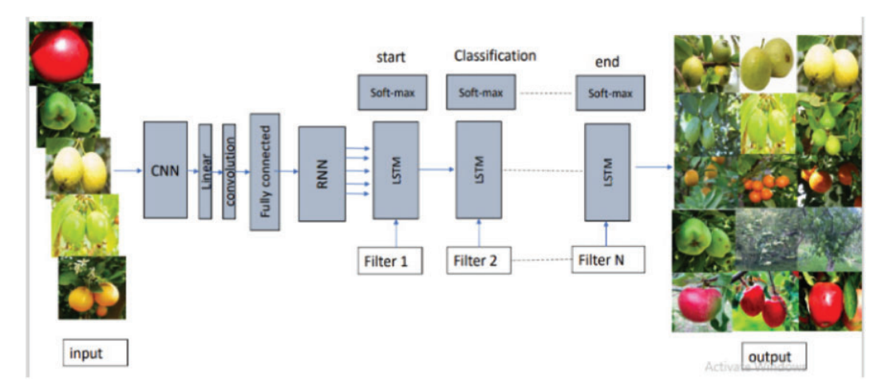
Classification fruit type

Slide 6
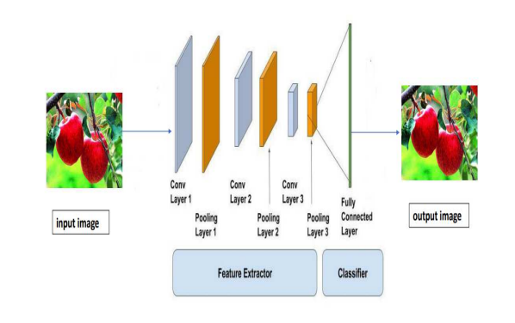
CNN

Slide 7
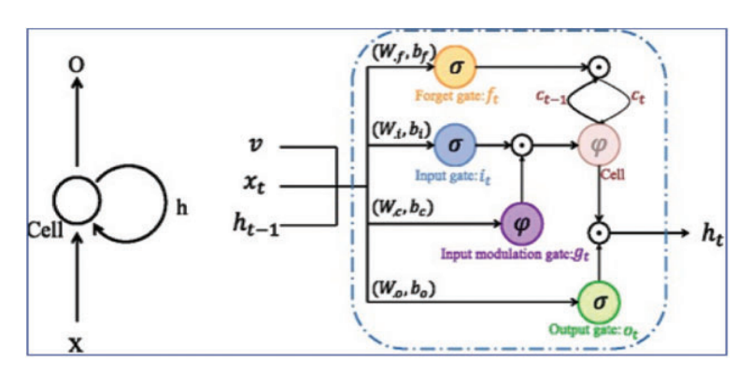
RNN - LSTM
RNN (left) and LSTM (right)

Slide 8
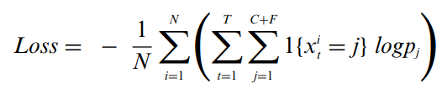
Loss function
Measure the difference between the predicted output and the actual output.
N - number of instances that is used to train the model.
T - the length of the input sequence that is processed by the RNN and LSTM layers.
C + F – “Coarse” features and “Fine” features.
X - indicates whether i sample belongs to j class or not.
P_{j} - indicates probability of sample belonging to j class.

Slide 9
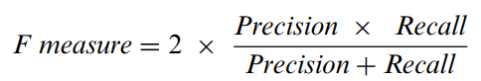
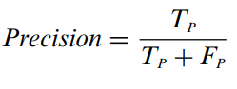
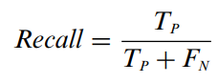
Evaluate the accuracy
Use the F measure to evaluate the accuracy of the fruit classification
Precision and recall are defined as:

Slide 10
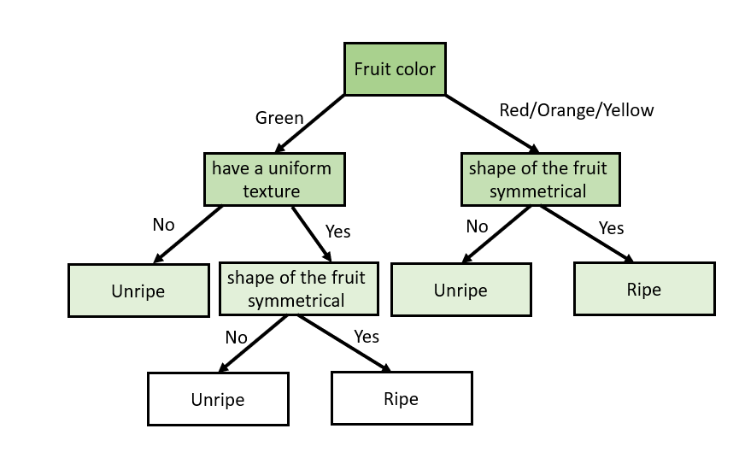
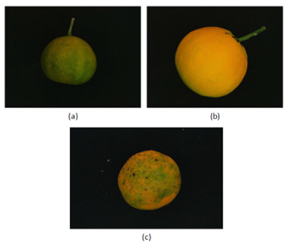
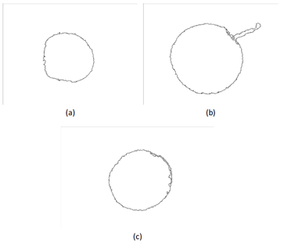
Classification the level fruit ripeness
Classify level fruit ripeness by using decision tree
Extract features such as color and border/interior pixel classification (BIC)
Original images
After BIC

Slide 11
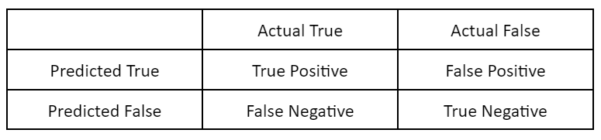
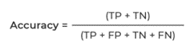
Evaluate the accuracy
Measure the distance between predicted and actual labels using Confusion matrix
The basic format of a confusion matrix

Slide 12
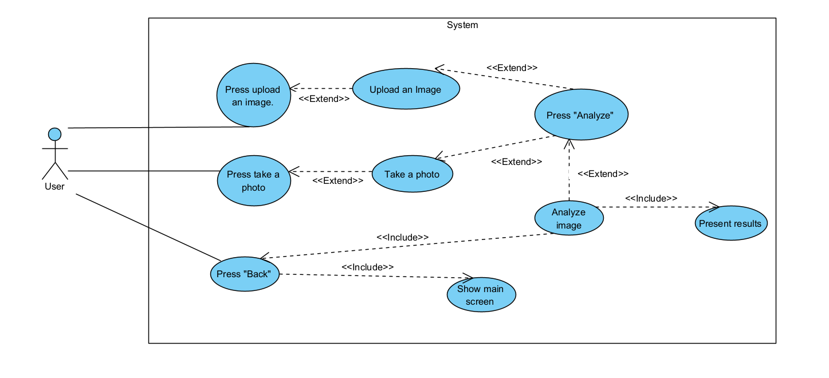
Use Case - Ripeness Fruits System

Slide 13
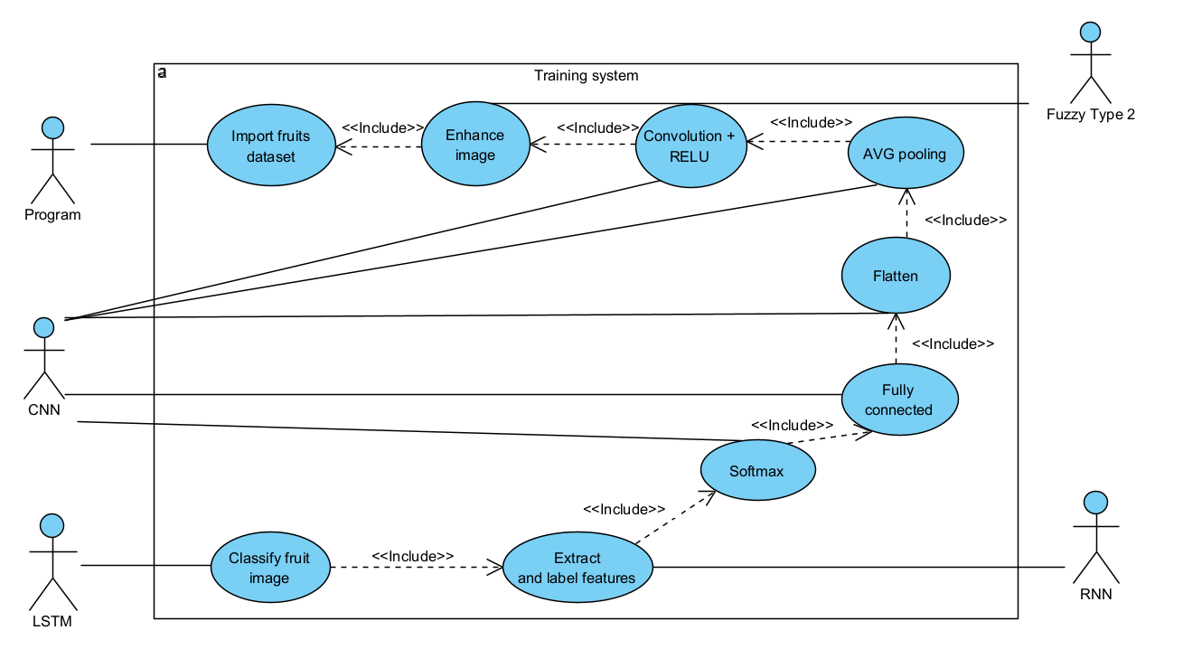
Use Case - Training

Slide 14
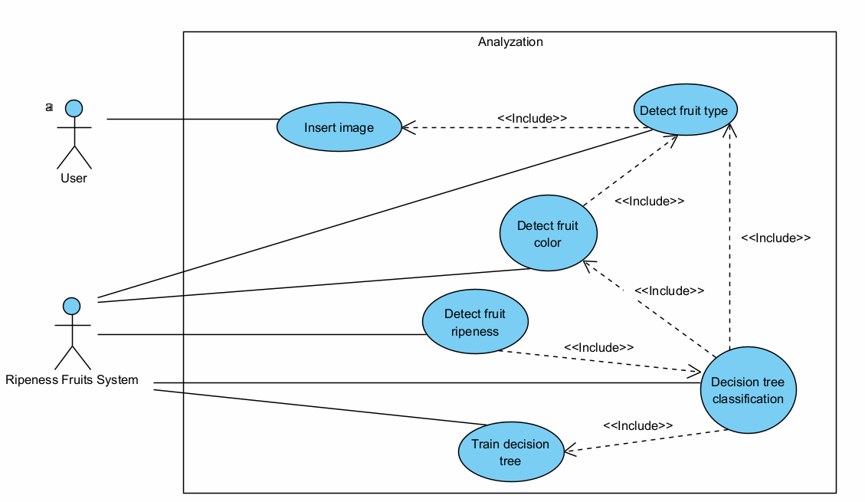
Use Case - Analyzation

Slide 15
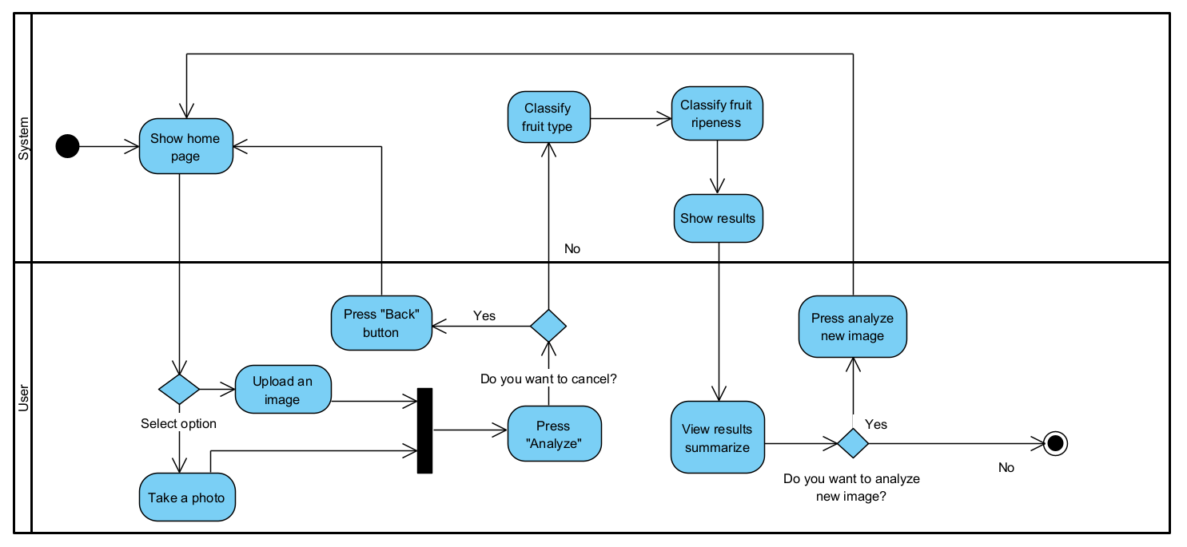
Activity - Ripeness Fruits System

Slide 16
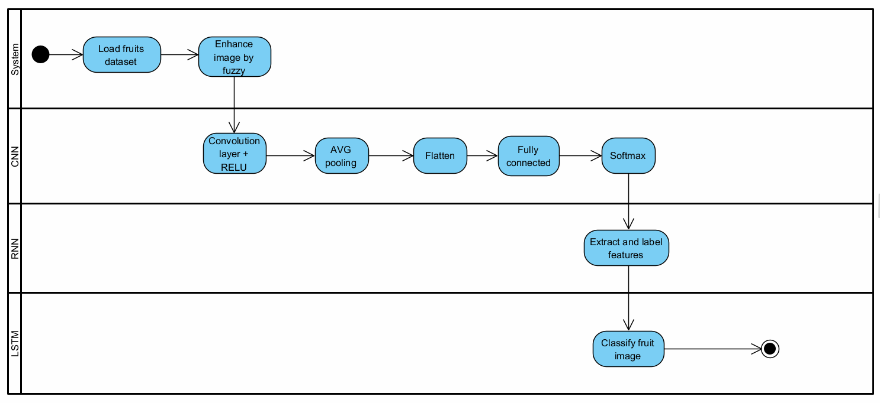
Activity - Training classify fruits model

Slide 17
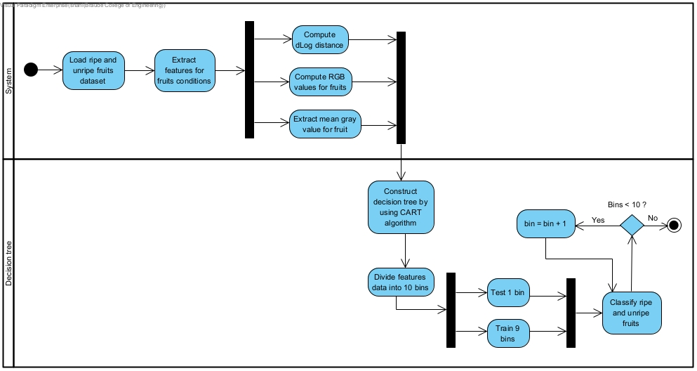
Activity - Training ripe and unripe fruits model

Slide 18
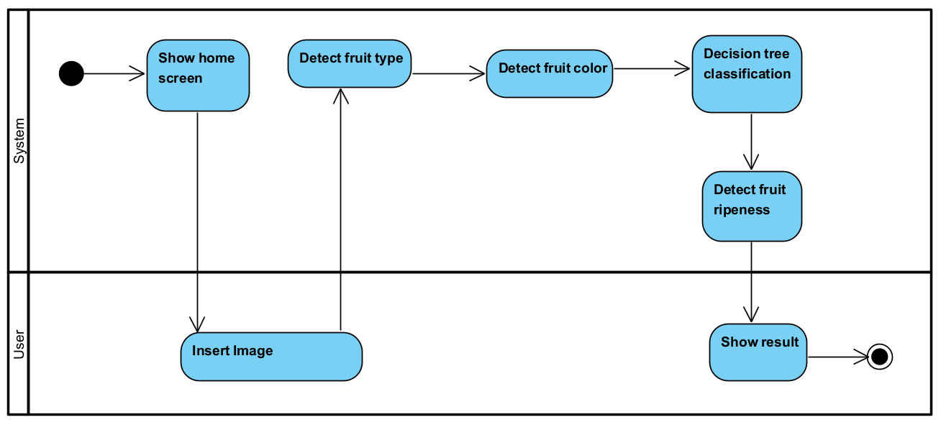
Activity - Analyzing

Slide 19
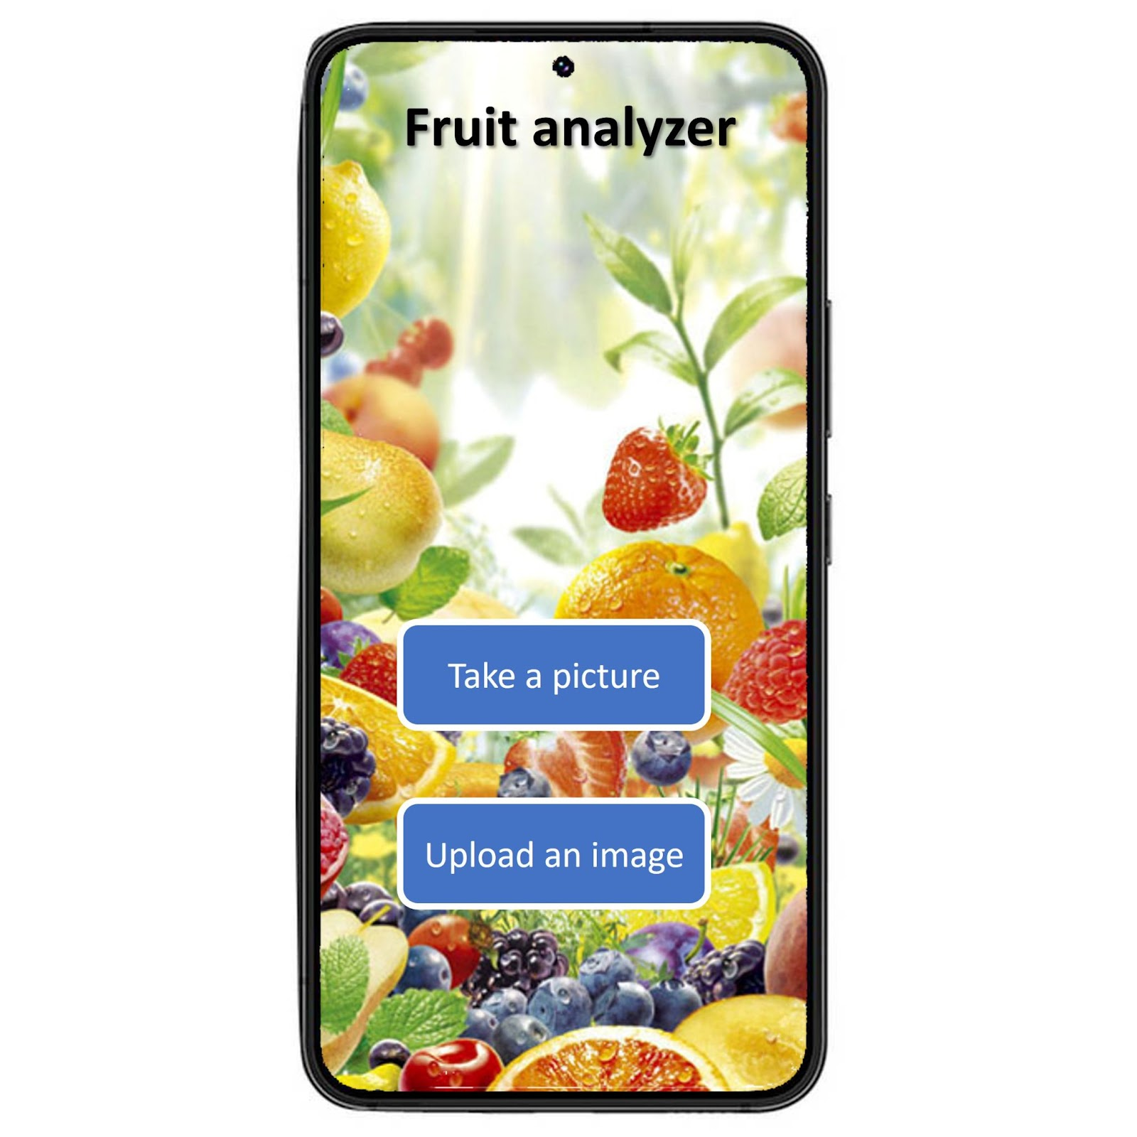
Main screen

Slide 20
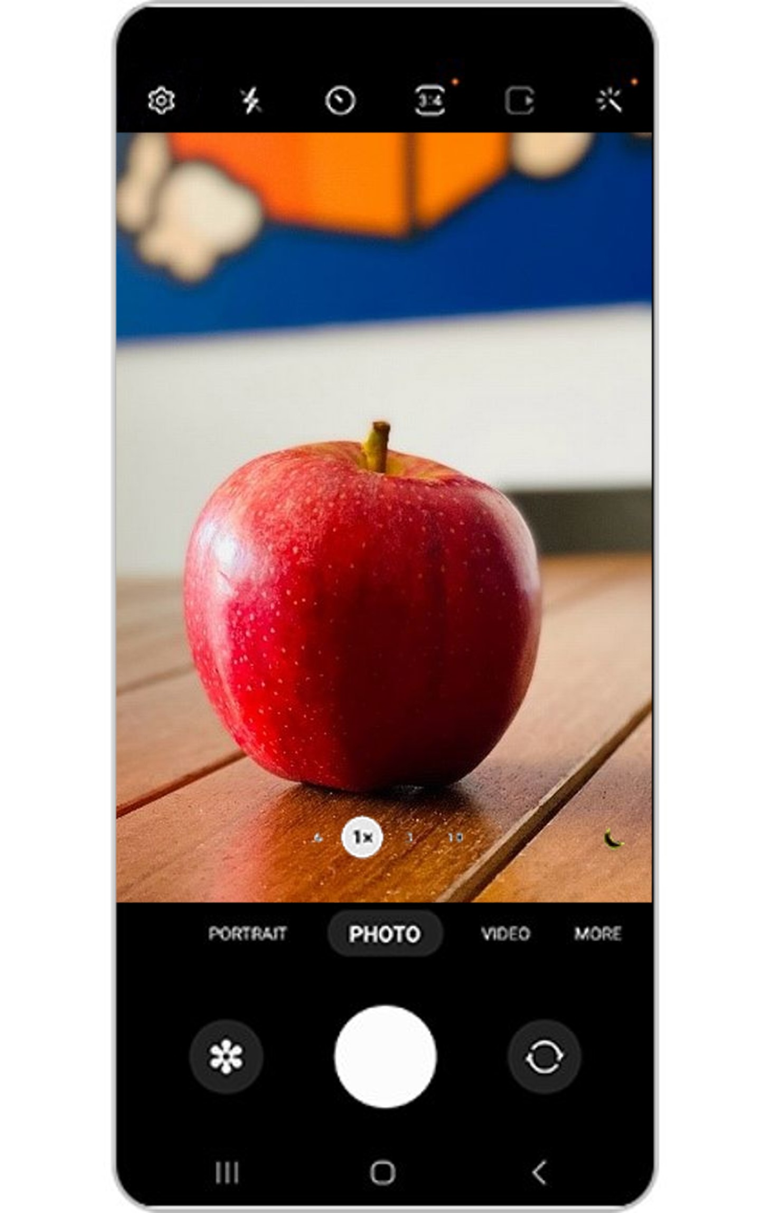
Take a picture

Slide 21
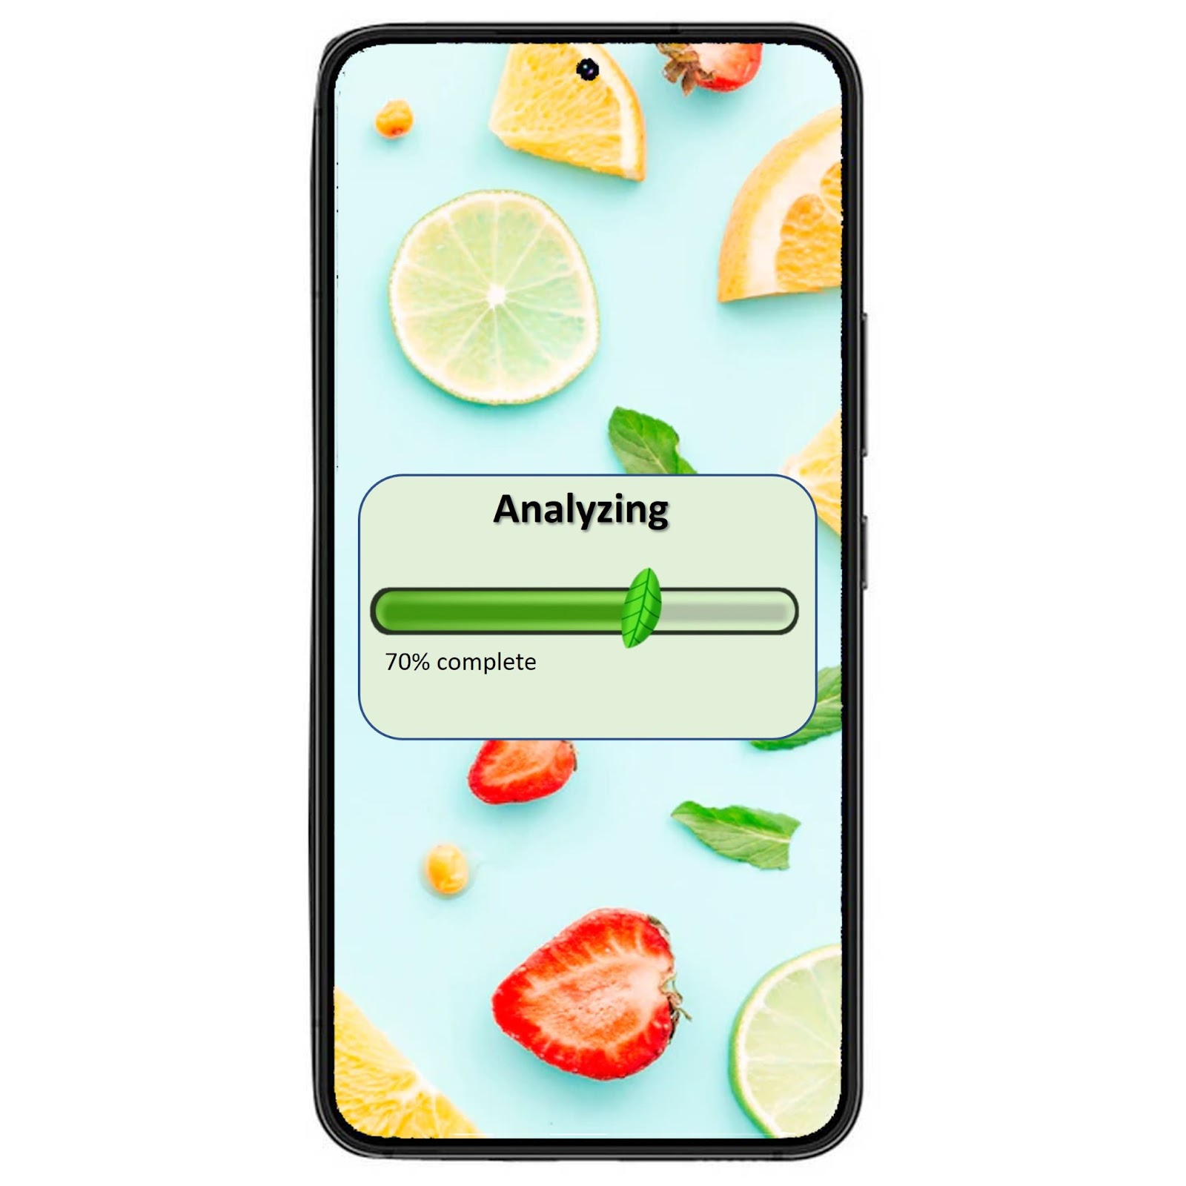
Analyzation Screen

Slide 22
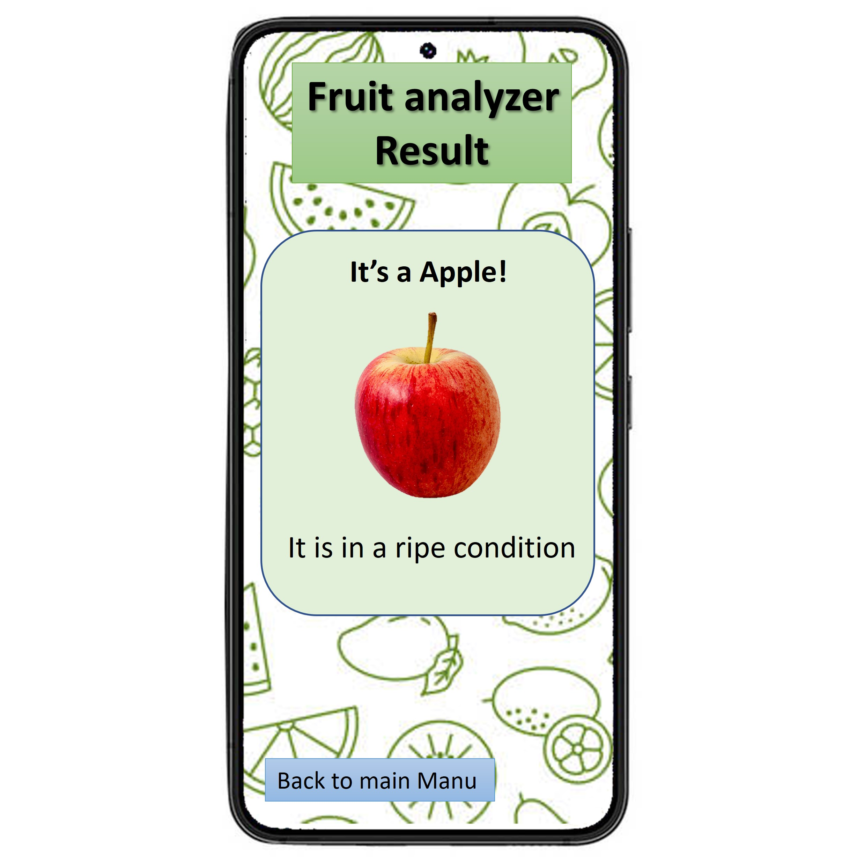
Result Screen

Slide 23
Evaluation Plan
Test ID | Test Description | Expected results
1 | User uploads a picture that is not of a fruit | System shows popup error message. Output: "No fruit detected".
2 | User uploads a file that is not an image | System shows popup error message. Output: "Please only upload a picture of a fruit".
3 | User uploads a picture of a ripe apple | System analyzes the image and shows that it is an apple and it is ripe
4 | User uploads a picture of an unripe apple | System analyzes the image and shows that it is an apple and it is unripe
6 | User uploads a picture of a scaled apple | System analyzes the image and shows that it is an apple and it is scaled
7 | User takes a photo of ripe orange | System analyzes the image and shows that it is an orange and it is ripe
8 | User takes a photo of unripe orange | System analyzes the image and shows that it is an orange and it is unripe
9 | User takes a photo of a scaled orange | System analyzes the image and shows that it is an orange and it is scaled
10 | User takes a photo that is not of a fruit | System shows popup error message. Output: "No fruit detected".

Slide 24
Summery
We present a fruit type classification model
We present a ripeness level classification model
We introduced the functionality of the system

Slide 25
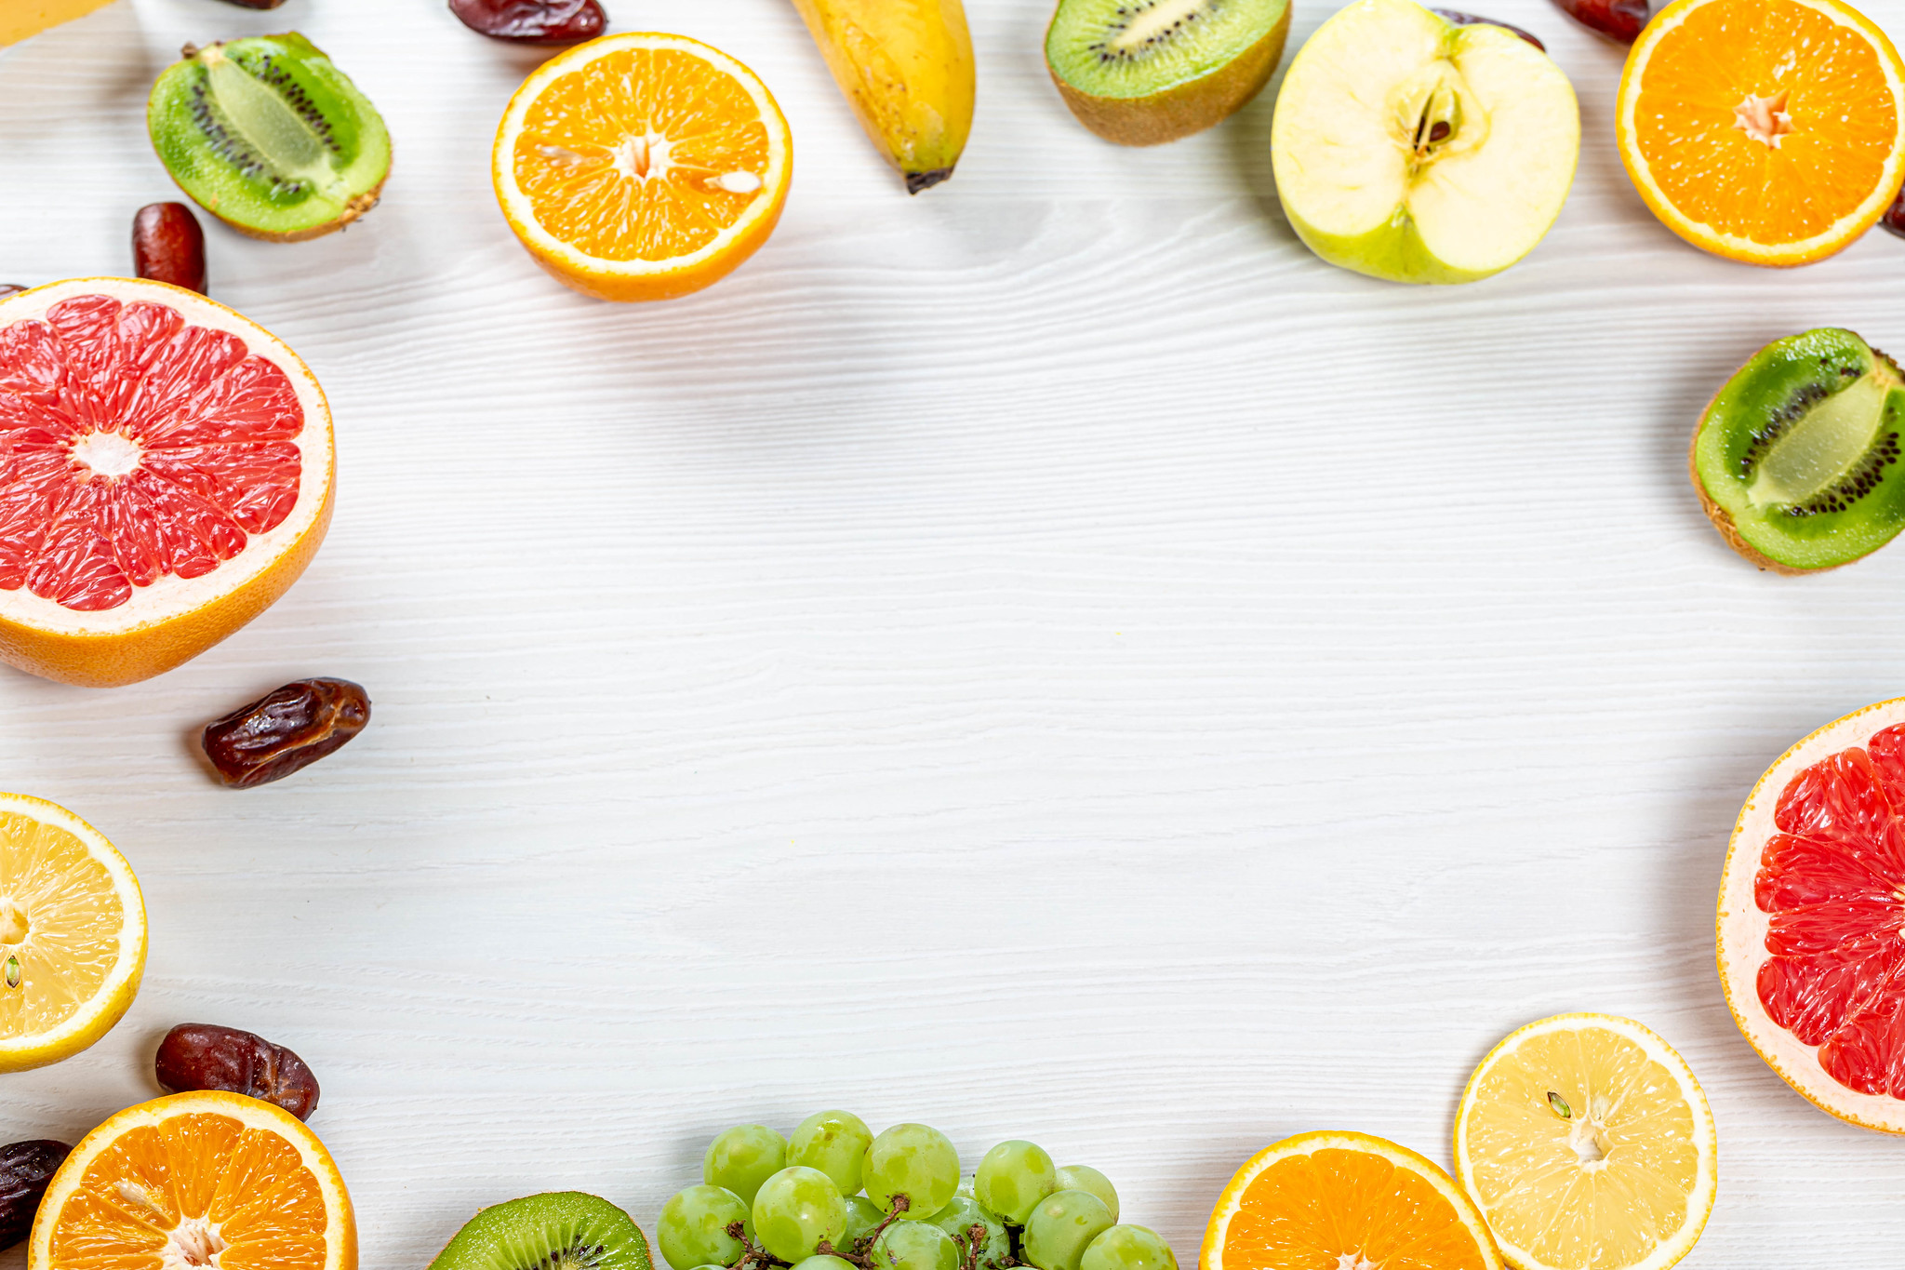
Thank you

